Slide 1
Encapsulation
Course Code: CSC 1205
Course Title: Object Oriented Programming 1
Dept. of Computer Science
Faculty of Science and Technology
Lecturer No: | 7 | Week No: | 4 | Semester: | Summer 19-20
Lecturer: | kawsur & kawsur@aiub.edu

Slide 2
Lecture Outline
Introduction to Encapsulation
Information Hiding
Access control
Example

Slide 3
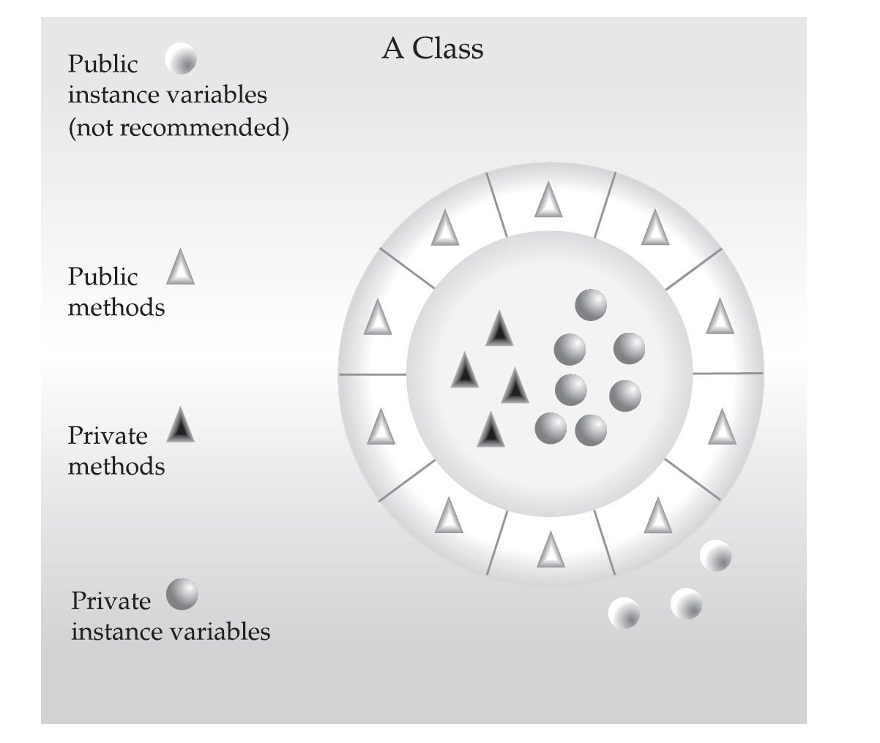
Introduction to Encapsulation
What is Encapsulation
Encapsulation is a primary attribute to OOP.
Encapsulation is the mechanism that binds together code and the data it manipulates and keeps both safe from outside interference and misuse.

Slide 4
Information Hiding
Encapsulation is a form of protection
Encapsulation is as a protective wrapper that prevents the code and data from being arbitrarily accessed by other code defined outside the wrapper.
So, the outside world does not have direct access to the internal implementation.
By hiding data and providing methods to gain access to it, an object can maintain high data integrity
Methods have the responsibility of maintaining data integrity

Slide 5
Access Control
What is Access Control
Encapsulation provides another important attribute: Access Control
There are two levels of access control:
At the top level—public, or package-private (no explicit modifier).
At the member level—public, private, protected, or package-private (no explicit modifier).
Access level modifiers determine whether other classes can use a field or invoke a method.

Slide 6
Access Control
Controlling Access to Members of a Class
At the top level—public, or package-private (no explicit modifier).
public
A class may be declared with the modifier public, in which case that class is visible to all classes everywhere.
Package-private
If a class has no modifier (the default, also known as package-private), it is visible only within its own package. (We will understand more about package-private, when we will study about packages).

Slide 7
Access Control
Controlling Access to Members of a Class
At the member level—public, private, protected, or package-private (no explicit modifier).
public
The public access modifier has the widest scope among all other access modifiers.
Methods or data members which are declared as public are accessible from every where in the program. There is no restriction on the scope of a public data members.
private:
The private modifier specifies that the member can only be accessed in its own class.

Slide 8
Access Control
Controlling Access to Members of a Class
protected
The protected modifier specifies that the member can only be accessed within its own package (as with package-private).
In addition, by a subclass of its class in another package.
package-private:
The data members or methods which are not declared using any access modifiers i.e. having default access modifier are accessible only within the same package.

Slide 9
Access Control
How to Achieve Encapsulation using Access Control Mechanism
As we know, encapsulation links data with the code that manipulates it.
Through encapsulation, we can control what parts of a program can access the members of a class.
Encapsulation can be achieved by: Declaring all the variables in the class as private and writing public methods in the class to set and get the values of variables.

Slide 10
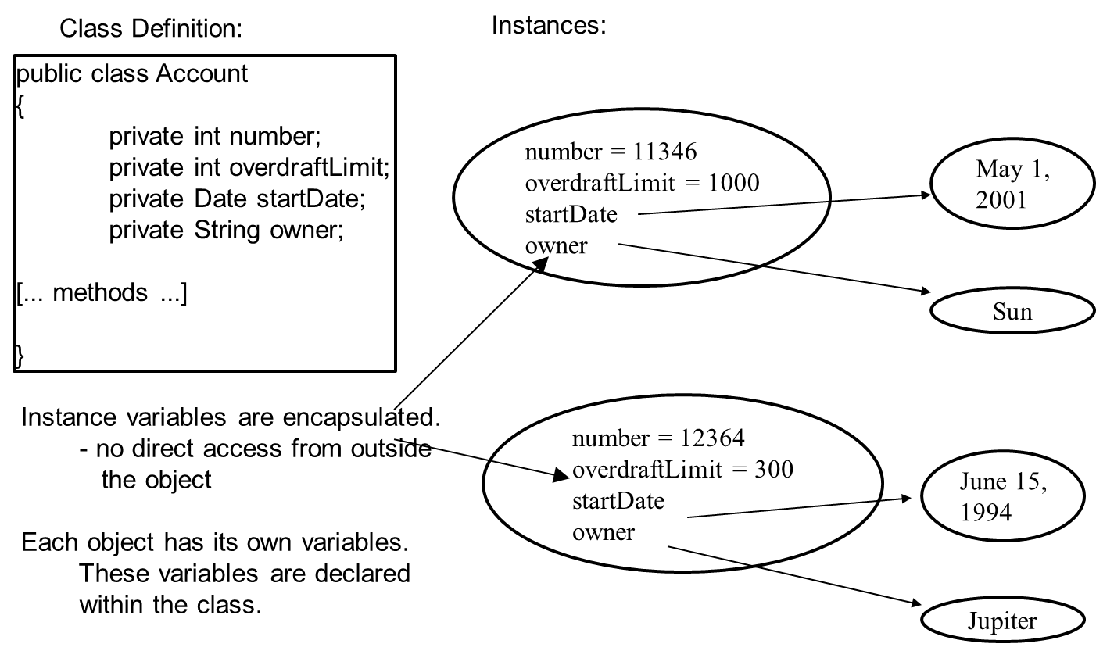
Example
Example

Slide 11
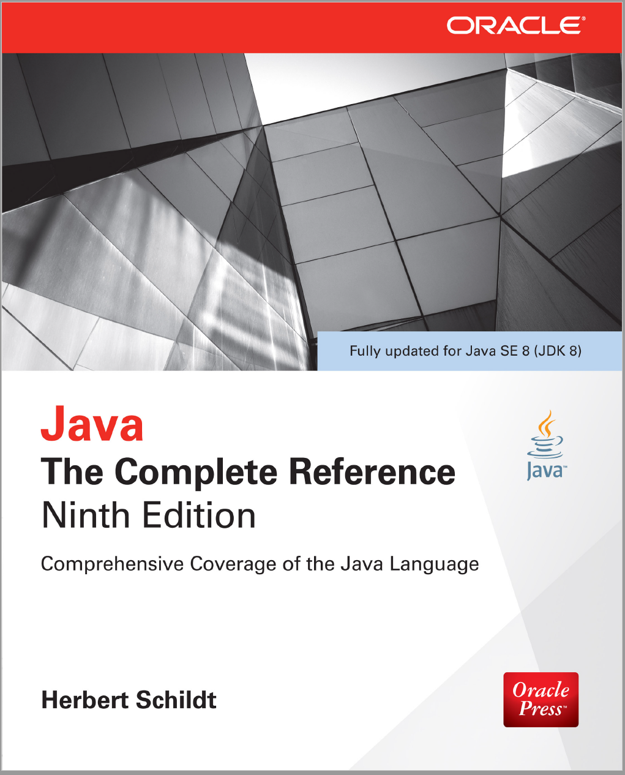
Books
Java The Complete Reference- Ninth Edition by Herbert Schildt

Slide 12
References
https://docs.oracle.com/javase/tutorial/

